Slide 1



Womens’ Tech Leap Alpharetta
Insert maybe a screenshot of the website
~ Our mission is to help guide the interest of young women in technology ~
Notes:
Emphasize this being a website that can be used for various schools and organizations

Slide 2

Into the future of Tech Alpharetta
Background of various professions directly on welcome screen
Personalized matching simply by creating your account for mentees
Dashboard of current mentors
A forum to engage in topics amongst the entire platform creating an open discussion
// add more
Notes:
A new way to be matched instantly with the perfect mentor;
We know that many young people do not know what career path they wish to pursue, well here is information of the careers of all of our mentors to share with you; this can be simply with links to various articles sorted A-Z
Healthcare, cybersecurity, marketing, project managers, CEOS, chief operating officers are a few

Slide 3

Insert welcome screen
Keep a blue color scheme for the website same as Tech Alpharetta's → inserting the welcome screen to show the information about the various careers of ; this will follow a description of how this was completed
Notes:
We wish to allow Mentees to have the opportunity to learn about the various career options with our welcome page, it will always be available to them but if this sign up process is given in classes it’s a way for them to do research prior to making a selection of 3 top professions upon login

Slide 4
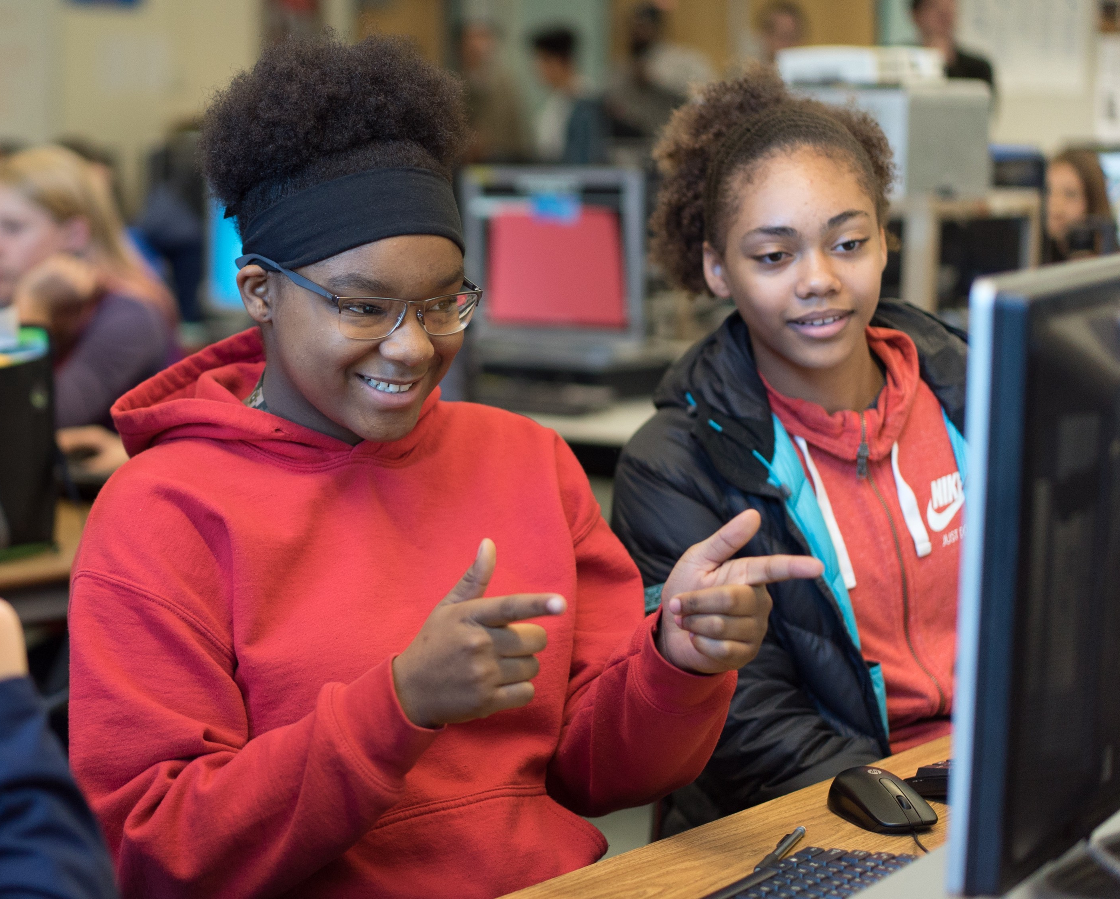

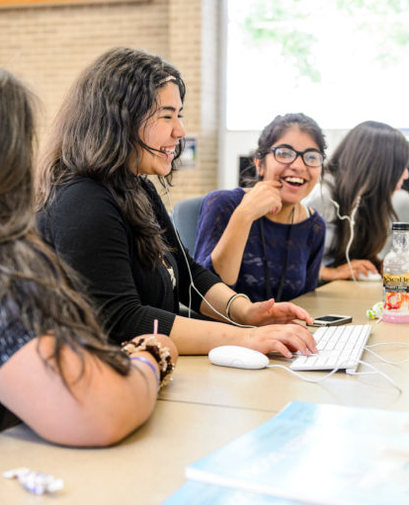

Personalized matching integrated in the creation of accounts
Create an account as a mentee: (highlight the option to login using social media, linkedin etc. )
First name last name
Birthdate // can highlight zodiac signs girls are into this when pairing with mentor
3 Top Professions of Interest
Mentor gender preference male, female, either
Virtual, In-person, or Hybrid
In-person indicates location by zip code and a preferred distance of mentor 5-15 miles
Availability
One Free Response question, “Explain what you wish to learn from your mentor, or hope to do?”
This account creation will create their profile with a reduced selection of mentors based on the mentee’s preferences.
~A website for all young women no matter the background ~
Notes:
Keeping our account creation simply and neat with relevant points
It can be indicated on this slide of later the way in which mentees will always have an option to engage in conversation via the forum just incase they see a mentor they may haven’t been exposed to based on their preferences
Mentors with slightly different availabilities or distances will still be shown just towards the end of the list with some kind of flag showing this difference ****

Slide 5

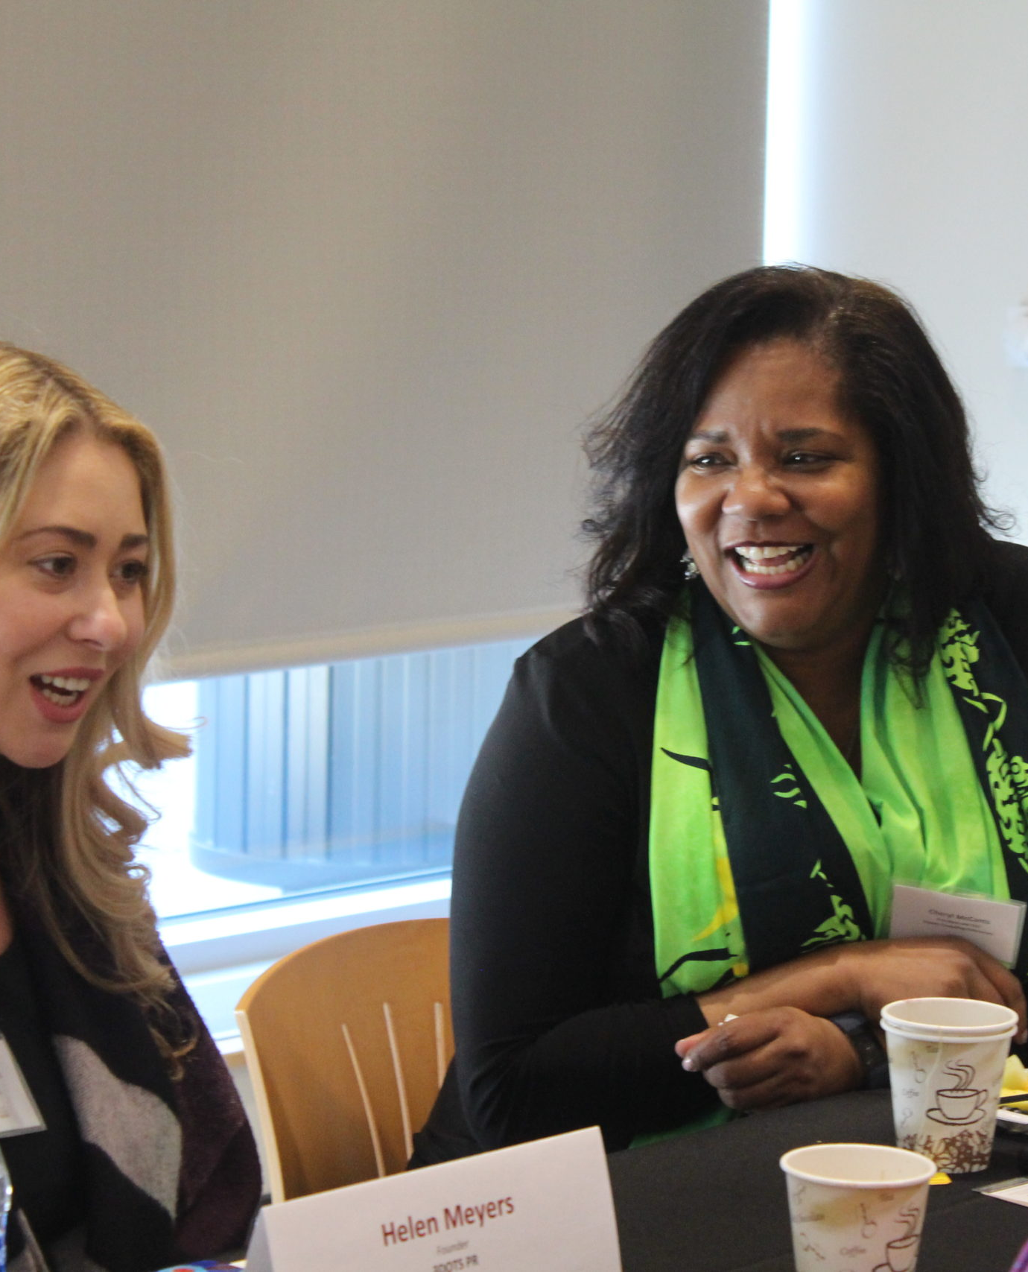

Personalized matching integrated in the creation of accounts
Create an account as a mentor: (highlight the option to login using social media, linkedin etc. )
First name last name
Birthdate // can highlight zodiac signs girls are into this when pairing with mentor
Virtual, In-person, or Hybrid
In-person indicates location by zip code and a preferred distance of mentor 5-15 miles
Availability
One Free Response question, “Explain what you wish to teach your mentee, or hope to do with your mentee?”
This account creation will put this mentee into the system after verification of this mentor being allowed to be apart of this program is determined. ( I am not sure how the verification of the mentor process works but we need to have some type of indication that we thought about this process)
Notes:
Keeping our account creation simply and neat with relevant points
It can be indicated on this slide of later the way in which mentees will always have an option to engage in conversation via the forum just incase they see a mentor they may haven’t been exposed to based on their preferences
Mentors with slightly different availabilities or distances will still be shown just towards the end of the list with some kind of flag showing this difference ****

Slide 6
Mentor form - This is the additional info the mentor provides upon being accepted- // may just input a screenshot of website
Subtitle
Subtitle
Add text, images, art, and videos.
Add transitions, animations, and motion.
Save to OneDrive, to get to your presentations from your computer, tablet, or phone.
Open the Design Ideas pane for instant slide makeovers.
When we have design ideas, we’ll show them to you right there.

Slide 7
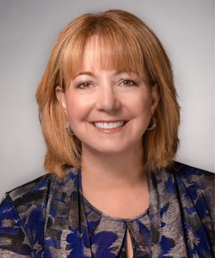
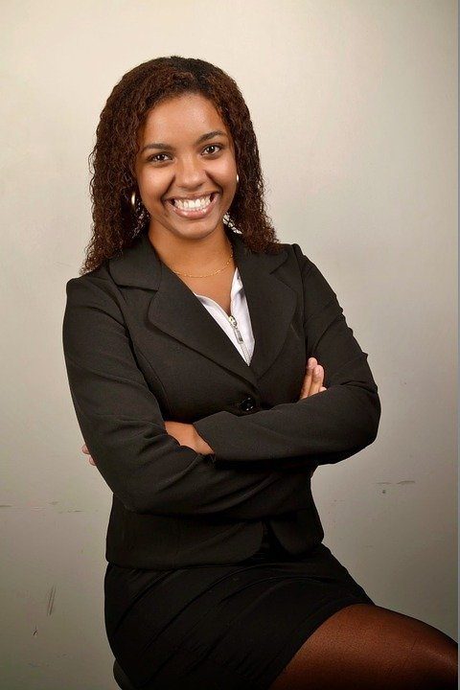

Mentor/Mentee dashboard
Michelle Linker
Abdul Altamimi
Founder & CTO, RestorePoint
Zodiac Sign: Capricorn
Unmatched Availability
Virtual Only
Goal:
Karen Cashion
Tech Alpharetta CEO
Zodiac Sign: Aries
Matched Availability
Hybrid
Goal:
3 Top Profession Interests:
Entrepreneurship, News Reporter, City Mayor
Zodiac Sign: Capricorn
Matched Availability
Hybrid
I wish to learn how to market myself, to someday become the CEO of my own start-up.
Notes:
This has the CEO of Tech Alpharetta as an example and other mentors already apart of tech alpharetta
These will each be clickable and after clicked mentee can see more information from each mentor, possible example projects, research, etc, further background of each mentor
When they click the mentor/mentee the detailed availability will pop up
Abduls skills:
“Grew his startup into highly successful mid-market company without giving up equity.”
Software evaluation Data analytics Cybersecurity Public/Private/Hybrid cloud
Will be shown when he is clicked

Slide 8
Tools, technologies, data collection
Initial match upon account creation
Deciphering goal statements
subtitle
Add text, images, art, and videos.
Add transitions, animations, and motion.
Save to OneDrive, to get to your presentations from your computer, tablet, or phone.
Open the Design Ideas pane for instant slide makeovers.
When we have design ideas, we’ll show them to you right there.
Add text, images, art, and videos.
Add transitions, animations, and motion.
Save to OneDrive, to get to your presentations from your computer, tablet, or phone.
Open the Design Ideas pane for instant slide makeovers.
When we have design ideas, we’ll show them to you right there.
Add text, images, art, and videos.
Add transitions, animations, and motion.
Save to OneDrive, to get to your presentations from your computer, tablet, or phone.
Open the Design Ideas pane for instant slide makeovers.
When we have design ideas, we’ll show them to you right there.

Slide 9
Unique features
- A mentor can also be a mentee by the creation of a separate account

Slide 10
Timeline of Mentee mentor matching (this is when we begin saying the highlights; time etc. )
I was thinking to emphasize how quick accounts can be made
Exploration of Mentors
Easy, proficient and readable
A way for mentees to see their options
During your presentation, the speaker notes are visible on your monitor, but aren't visible to the audience.
Title
Title
If you don’t see the Notes pane or it is completely minimized, click Notes on the task bar across the bottom of the PowerPoint window.
The Notes pane is a box that appears below each slide. Tap it to add notes.
Account Creation

Slide 11

The way to get started is to quit talking and begin doing.
Walt Disney

Slide 12

Thank you
With PowerPoint, you can create presentations and share your work with others, wherever they are. Type the text you want here to get started. You can also add images, art, and videos on this template. Save to OneDrive and access your presentations from your computer, tablet, or phone.

